Slide 1
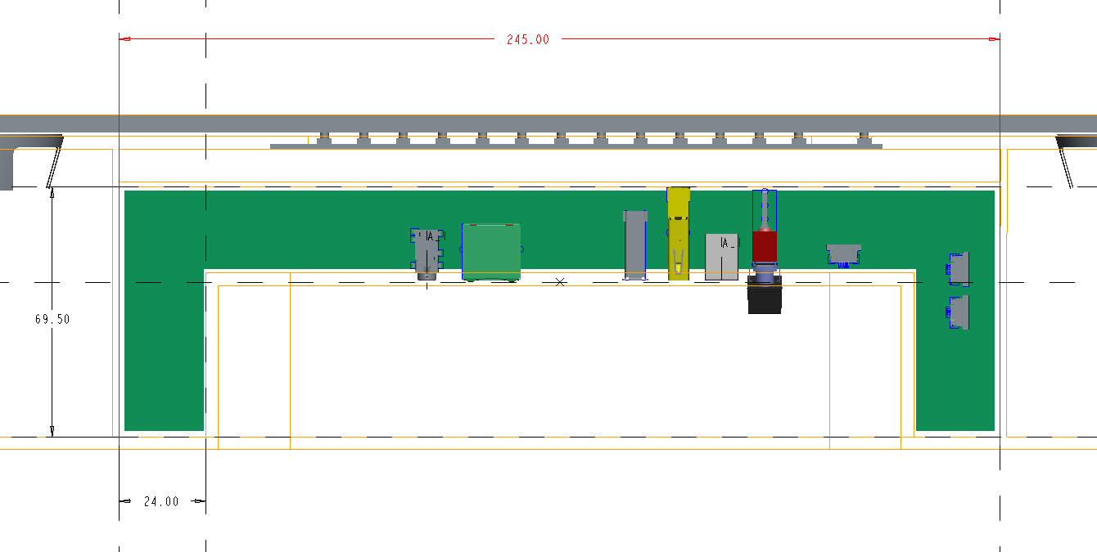
Allowed PCB cabinet dimensions for latest ID(mm):

Slide 2
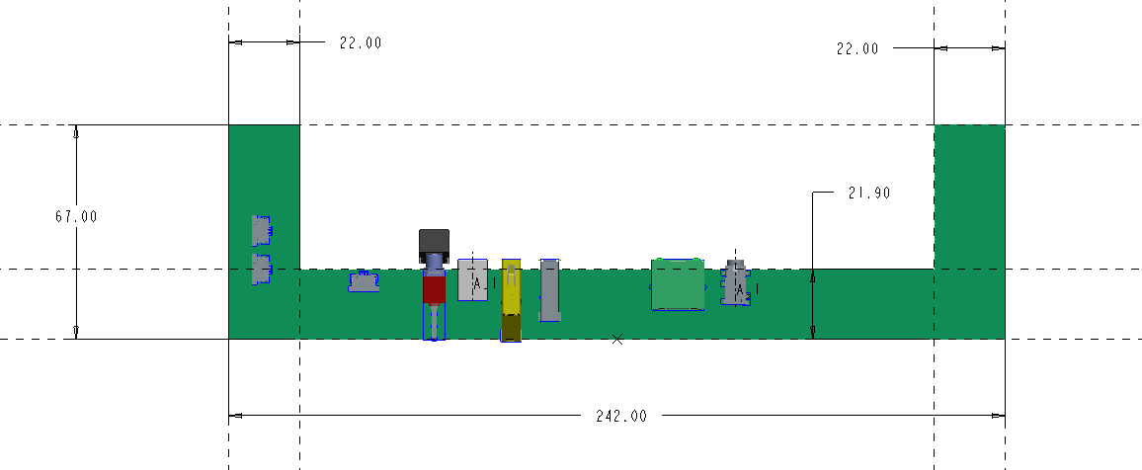

Modified PCB outlet to fit the current cabinet of sound bar latest ID:

Slide 3
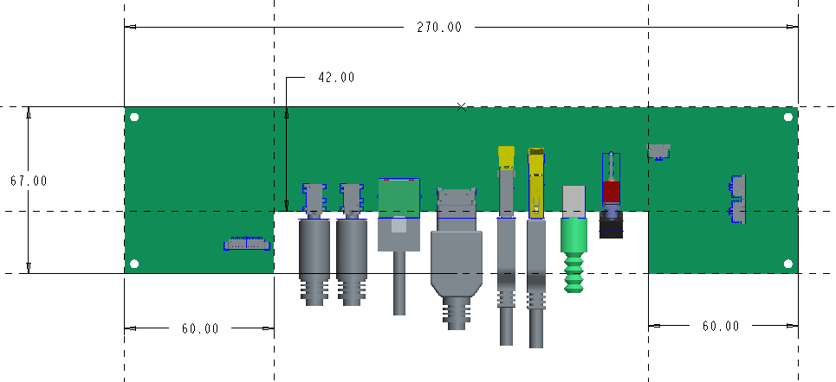
Recommended workable PCB dimensions by Foxconn team as below:
270*67mm
Top view of PCB

Slide 4
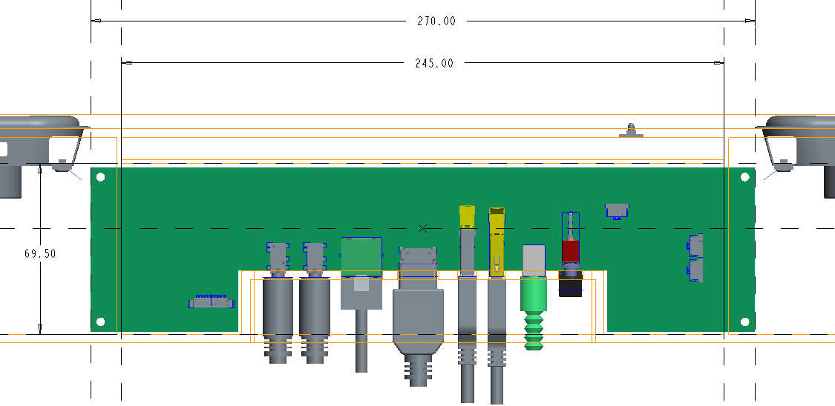
PCB needs to be withdrew 5-10 mm first before inserting the power switch into IO openings on housings, so we need customer to evaluate that : if there is no another design feature or components are placed on withdraw area ?
Another solution is : the main PCB can be installed firstly, then next to install another board, or LED board can be integrated with Main PCB together.
New cabinet design:
20mm
3. Need to evaluate if the PCB cabinet would be designed as L275*W69.50mm?

Slide 5
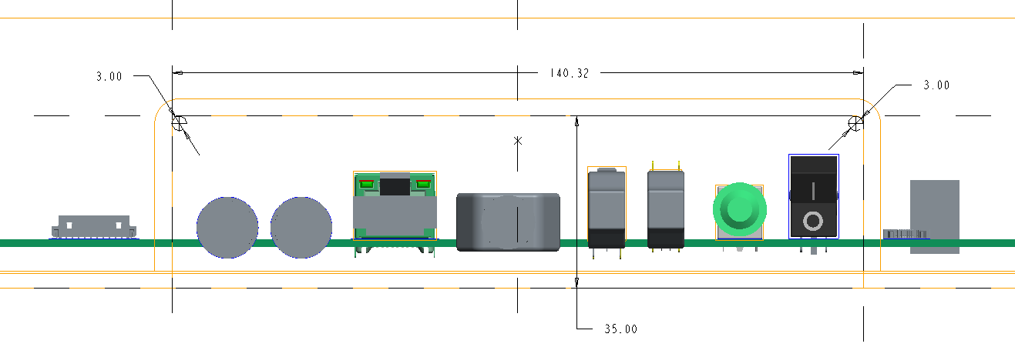
Side view of PCB:
Need customer to evaluate if the back-panel of ID can be modified as below:
Modified to be R1.5 from original R20mm

Slide 6
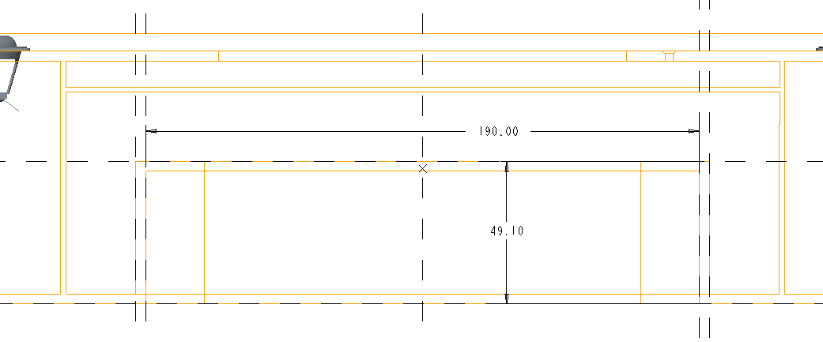
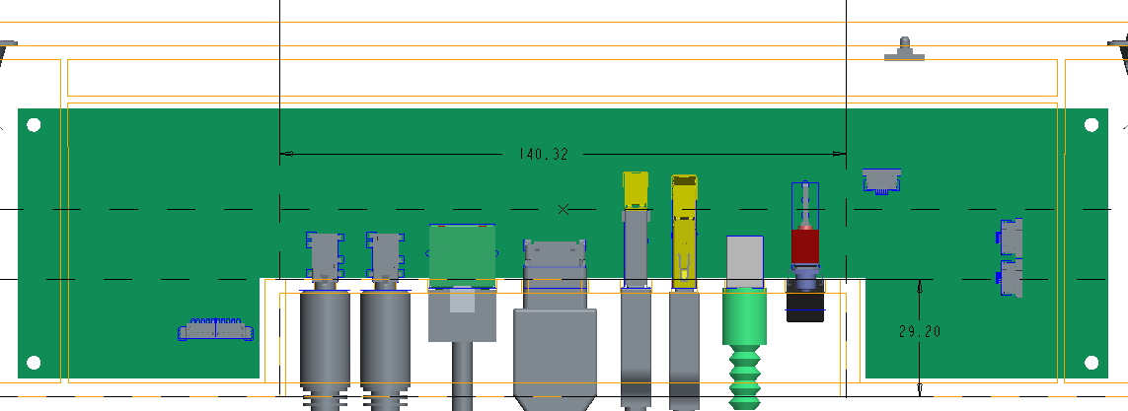
So, pls evaluate that if the ID back-panel area could be modified as below:
190mm
49.10mm
modify to be 142.32*29.20 from 190*49.10mm
142.32mm
29.20mm

